Slide 1
U2 M1 L3 Force Pairs

Slide 2
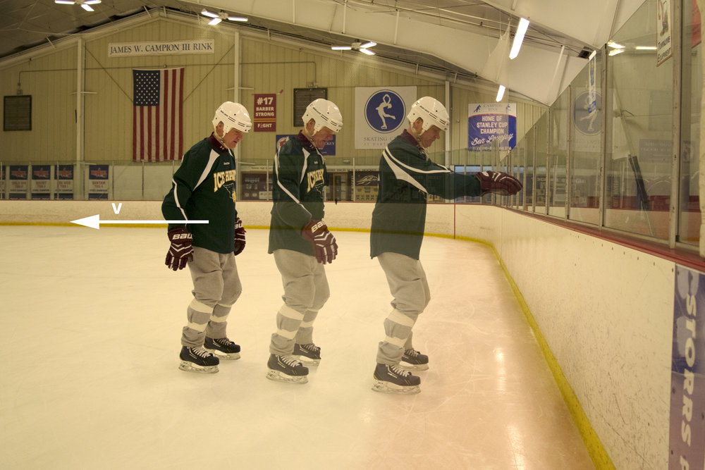
What forces are present when you push an object?
If you are wearing skates and push against a wall, you will move away from the wall. What force causes you to move?

Slide 3
Opposing Forces
You might think that the force of your muscles moves you away from the wall. Think about the direction of your push. Your push is against the wall in the opposite direction from your movement.
In fact, when you push against the wall, the wall pushes back in the opposite direction. The push of the wall causes you to accelerate away from the wall. When an object applies a force on another object, the second object applies a force of the same strength on the first object, but the force is in the opposite direction

Slide 4
Newton’s third law
Newton’s first two laws of motion describe the effects of balanced and unbalanced forces on one object.
Newton’s third law relates forces between two objects.
According to Newton’s third law of motion, when one object exerts a force on a second object, the second object exerts a force of the same size but in the opposite direction on the first object.

Slide 5
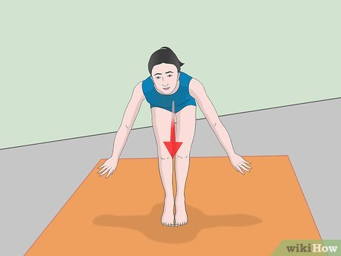
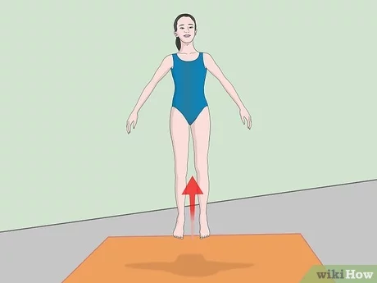
An example of forces described in Newton’s third law of motion is a gymnast pushing against the floor during a flip. When the gymnast applies force against the floor, the floor applies force back.

Slide 6
Force Pairs
The forces described by Newton’s third law depend on each other.
A force pair is the forces two objects apply to each other. You can add forces to calculate the net force. If the forces of a force pair always act in opposite directions and are always the same strength, why don’t they cancel each other?
The reason is that each force acts on a different object.
Adding forces results in a net force of zero only if the forces act on the same object.

Slide 7
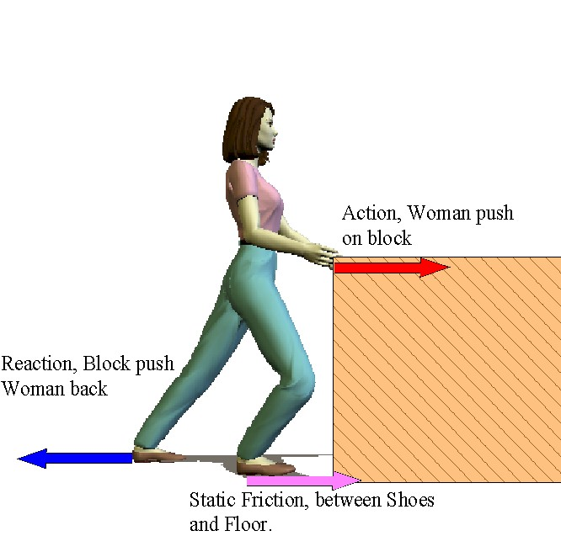

Slide 11
Normal Force
The force that pushes back is sometimes called the normal force.
The normal force pushes perpendicular to the object’s surface. Think about what happens when you push a wall. The wall has a normal force that pushes straight out from the wall. The force pair is balanced in this case. Now think of a tennis ball hitting a tennis racket. The racket applies a normal force that is perpendicular to the racket. A tennis player will turn her racket when she wants to turn the ball left or right. The racket then applies a normal force in the direction the player wants the ball to go.

Slide 12
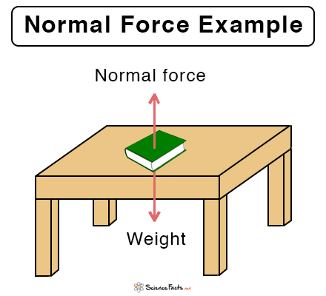

Slide 13
What happens during a collision?
In a game of billiards, when the moving cue ball hits a ball that is not moving, the motion of both balls changes. When the cue ball hits the other ball, the cue ball’s velocity decreases and the other ball starts moving. Collision Forces When one object collides with another object, a force is applied to the second object. The second object accelerates in the direction of the force. However, because of Newton’s third law a force is also applied to the first object

Slide 15
Types of Collisions
When colliding objects bounce off each other, an elastic collision occurs, as shown in the figure. If objects collide and stick together, the collision is inelastic

